Slide 1
MILESTONE 3 PROGRESS
Group:
Nicolas Rincon-Speranza
Lawson Darrow
Nikiraj Konwar
Christian Stevens
Advisor:
Dr. Zahra Nematzadeh

Slide 2
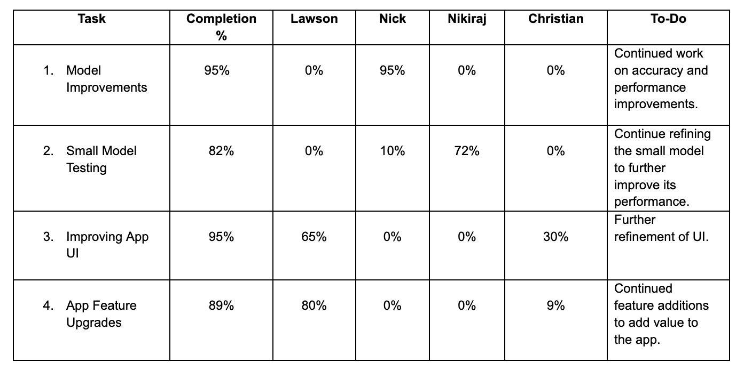
Milestone 3 Task Matrix

Slide 3
Small Model
Model: MobileNetV2 lightweight prototype for early experimentation
Dataset: Balanced 3,000 images (1,500 benign / 1,500 malignant)
Training: Two-stage approach
Train classification head only (5 epochs)
Fine-tune last 10 layers with lower learning rate
Techniques Applied:
Class weighting for malignant emphasis
Light augmentation (flip, rotation, zoom)
Early stopping based on validation AUC

Slide 4
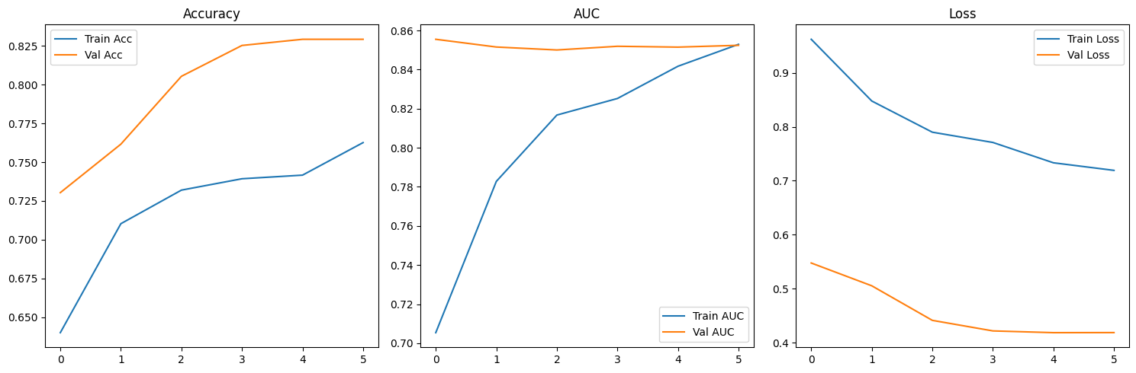
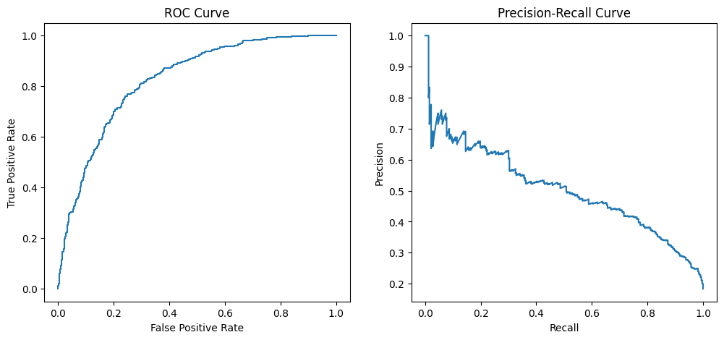
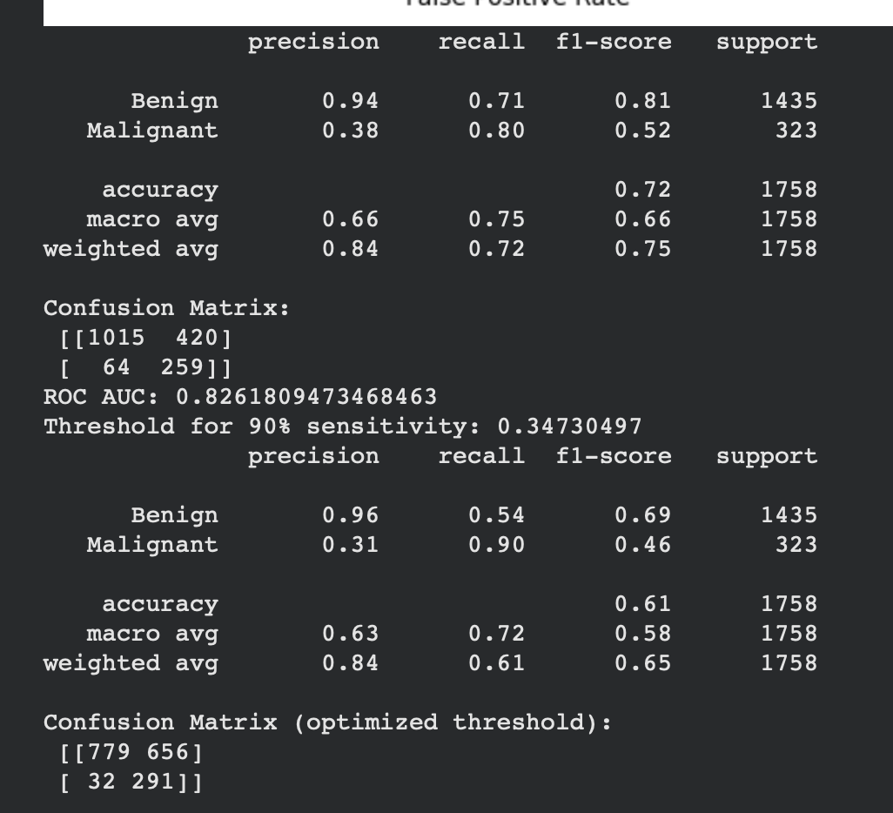
Small Model Outputs

Slide 5
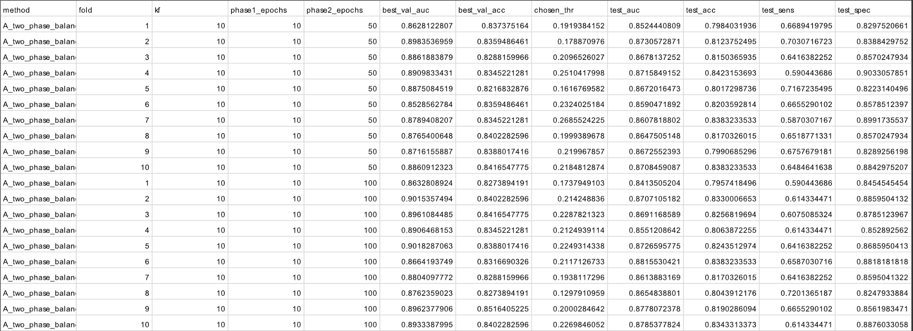
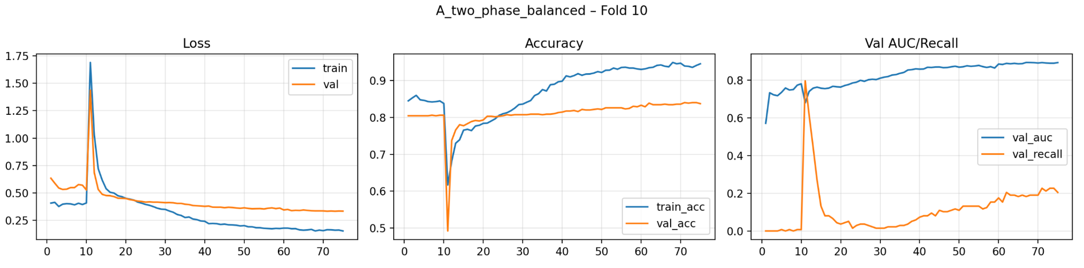
Before New Model Improvements

Slide 6
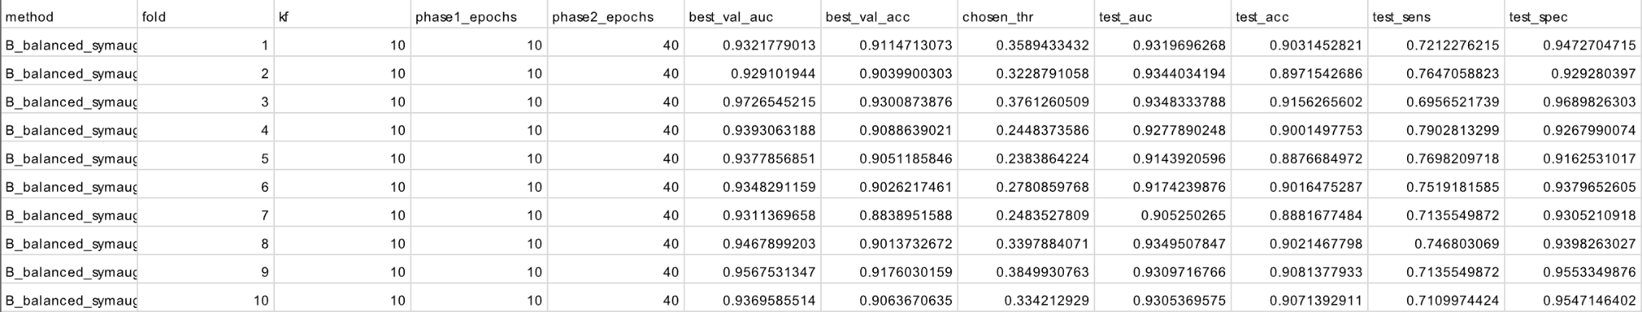
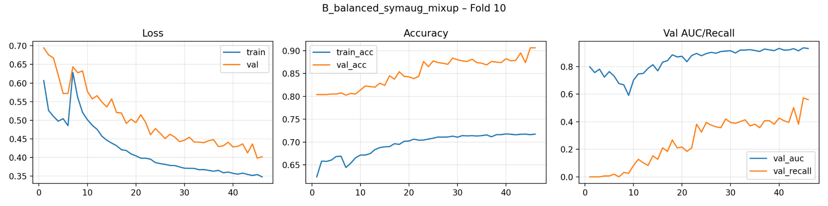
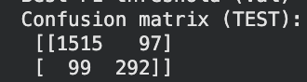
After New Model Improvements
Actual Benign
97 False Positives
99 False Negatives
Actual Malignant
Predicted Benign
Predicted Malignant

Slide 7
UI Modifications
Switched framework from Flutter to React Native
Easier to implement visual elements
Easier access to native modules such as camera and file system
libraries like:
react-native-camera
react-native-image-picker
integrate with device hardware
Features:
Screen Navigation & Icons
Toggles & Widgets

Slide 8

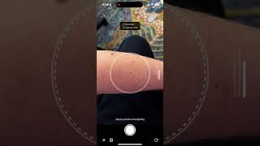
App Demo

Slide 9
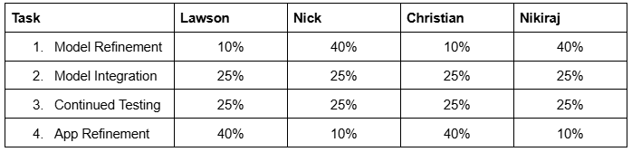
Milestone 4 Task Matrix

Slide 10
THANK YOU!
Any Questions

